Slide 1

Django Learner Lab
Part 1
Fundamentals of web development frameworks and associated tools

Slide 2
Why Do This?
This can be the part of the presentation where you introduce yourself, write your email…

Slide 3
Table of contents
01
02
03
04
05
06
What’s a Web Framework?
Back to Front Ends
IDEs & Git Versioning
Project Contents & Deployment
APIs & Testing
Learner Labs

Slide 4

01
What’s in a Framework?
Notes:
WHAT IS DJANGO
- web dev framework definition
- the features that define it (MVC, ORM, RESTful API's, etc)
- why use it at all/whats it for
- where it fits in the big picture (controller, provides api's and connection to model - options for storage and front ends)
- provides standarized directory structure and boilerplate code
----- mvc infographic
COMPARISON
- comparison to alternative web dev frameworks (ruby on rails (ruby), laravel (php), asp.net (c#))
- what differentiates one framework from the next - language, directory structure, boilerplate code
- use cases
LANGUAGE
- what is python/what defines it (dynamically typed, interpreted language, high level)
- what is a virtual environment and benefits/how to use

Slide 5
Components of a Framework
Language
Neptune is the farthest planet from the Sun
Directory Structure
Jupiter was named after a Roman god
Digital Transformation
Boilerplate Code
Mercury is the closest planet to the Sun
Standard Methods
Venus is the second planet from the Sun

Slide 6
Web Development Requirements
from pptx import Presentation
MVCs
Front to Back connections
Separation of concerns
Modular/micro services
Security
Least privilege for each component
One project – multiple apps
Importance of the ‘Controller’ and how web dev frameworks facilitate this
Mercury is the closest planet to the Sun and the smallest one in the entire Solar System. This planet's name has nothing to do with the liquid metal, since Mercury was named after the Roman messenger god. Despite being closer to the Sun than Venus, its temperatures aren't as terribly hot as that planet's. Its surface is quite similar to that of Earth's Moon, which means there are a lot of craters and plains
Speaking of craters, many of them were named after artists or authors who made significant contributions to their respective fields. Mercury takes a little more than 58 days to complete its rotation, so try to imagine how long days must be there! Since the temperatures are so extreme and the solar radiation is so high, Mercury has sadly been considered to be non-habitable for humans

Slide 7
Model View Controller
Model
View
Venus is the second planet from the Sun
It’s the biggest planet in the Solar System
Datastore
User Interface
Jupiter doesn’t have a solid surface
Saturn is a gas giant and has several rings
Back End
Front End
Earth is the only planet that harbors life
Despite being red, Mars is actually a cold place

Slide 8





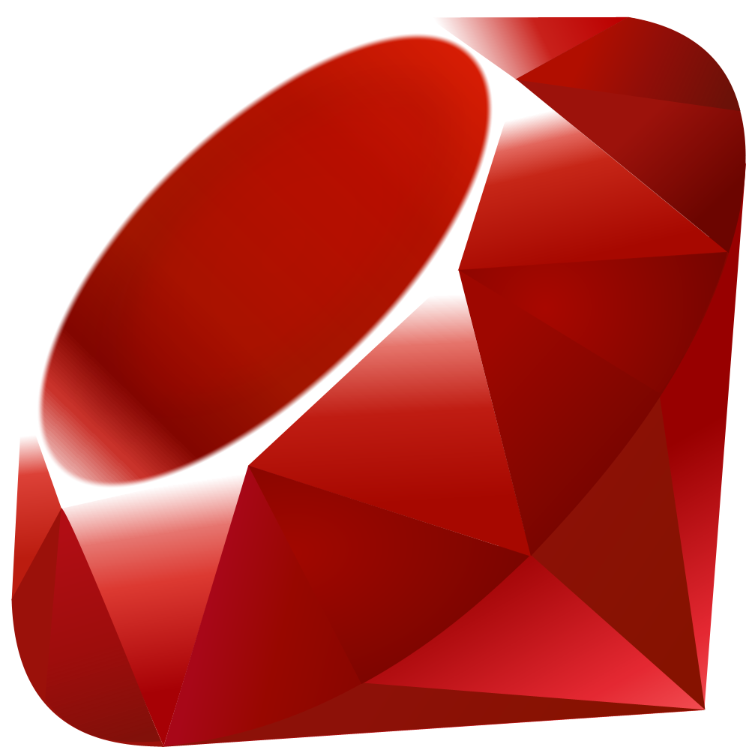

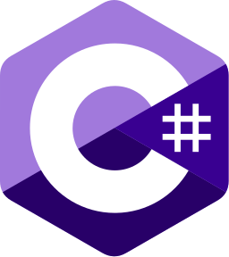
Popular Web Development Frameworks
Django | Ruby on Rails | Laravel | ASP.NET
Python | Ruby | PHP | C#
Example 1 Example 2 Example 3 | Example 1 Example 2 Example 3 | Example 1 Example 2 Example 3 | Example 1 Example 2 Example 3

Slide 9
Which Framework Should You Use?
Driving Factors
Benefits of Django
Current tech stack in use
Compatibility with existing components
Familiarity with framework
Familiarity with programming language
Cost
Speed
Reliability
Venus has a beautiful name and is the second planet from the Sun. It’s terribly hot—even hotter than Mercury—and its atmosphere is extre

Slide 10
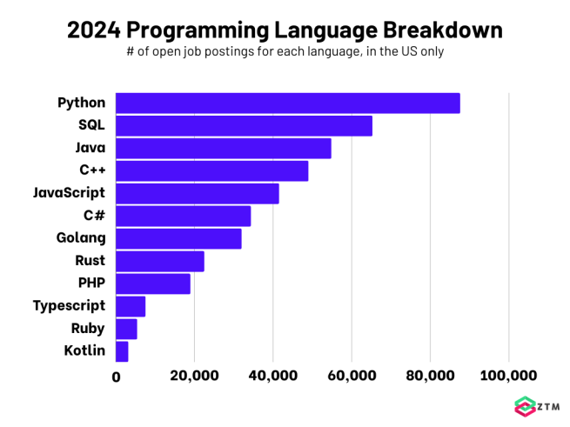
Lets talk about Python!
Do you know what helps you make your point crystal clear? Lists like this one:
They’re simple
what is python/what defines it (dynamically typed, interpreted language, high level)
what is a virtual environment and benefits/how to use
And the most important thing: the audience won’t miss the point of your presentation

Slide 11
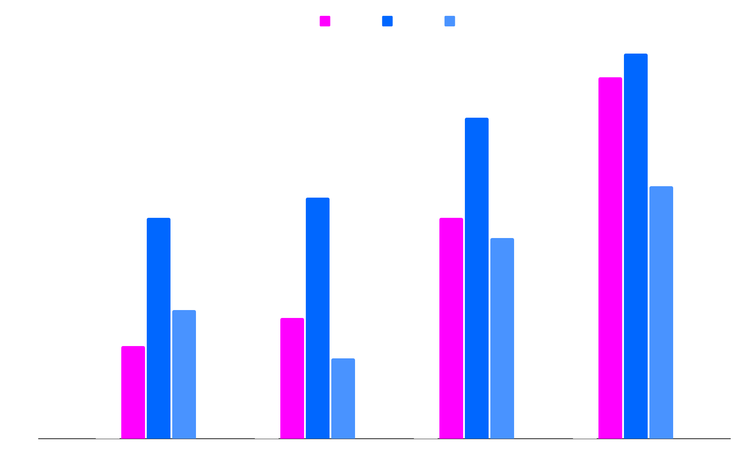
Edit for Python
Team 1
Team 2
Team 3
Team 4
Follow the link in the map to modify its data and then paste the new one here. For more info, click here

Slide 12
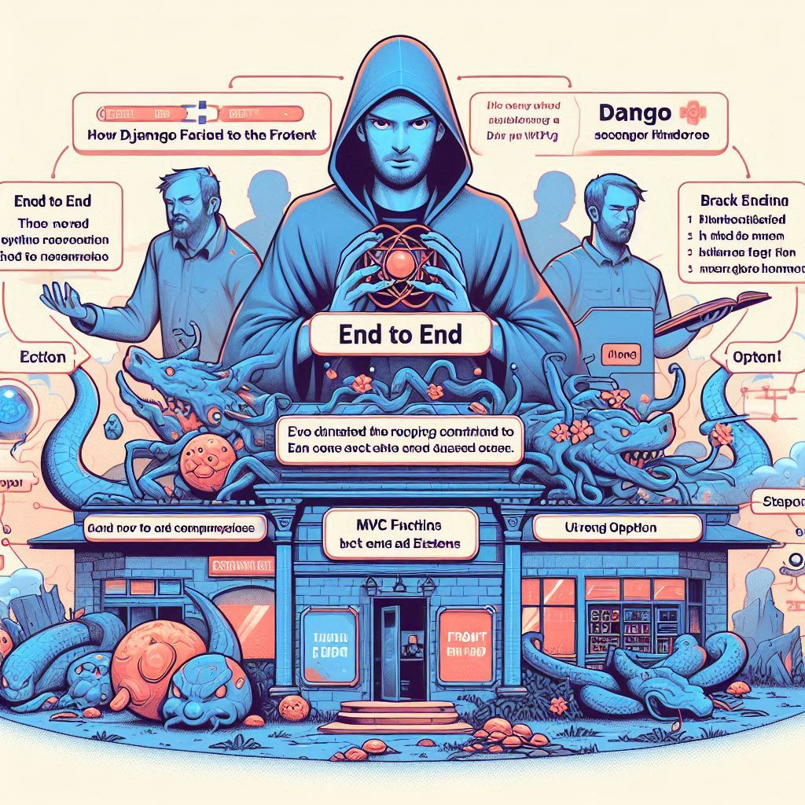
02
Back to Front Ends

Slide 13
The Back End
from pptx import Presentation
Speak to how the back end provides the datastore for the project. Requirements
CIA triangle
Mercury is the closest planet to the Sun and the smallest one in the entire Solar System. This planet's name has nothing to do with the liquid metal, since Mercury was named after the Roman messenger god. Despite being closer to the Sun than Venus, its temperatures aren't as terribly hot as that planet's. Its surface is quite similar to that of Earth's Moon, which means there are a lot of craters and plains
Speaking of craters, many of them were named after artists or authors who made significant contributions to their respective fields. Mercury takes a little more than 58 days to complete its rotation, so try to imagine how long days must be there! Since the temperatures are so extreme and the solar radiation is so high, Mercury has sadly been considered to be non-habitable for humans

Slide 14
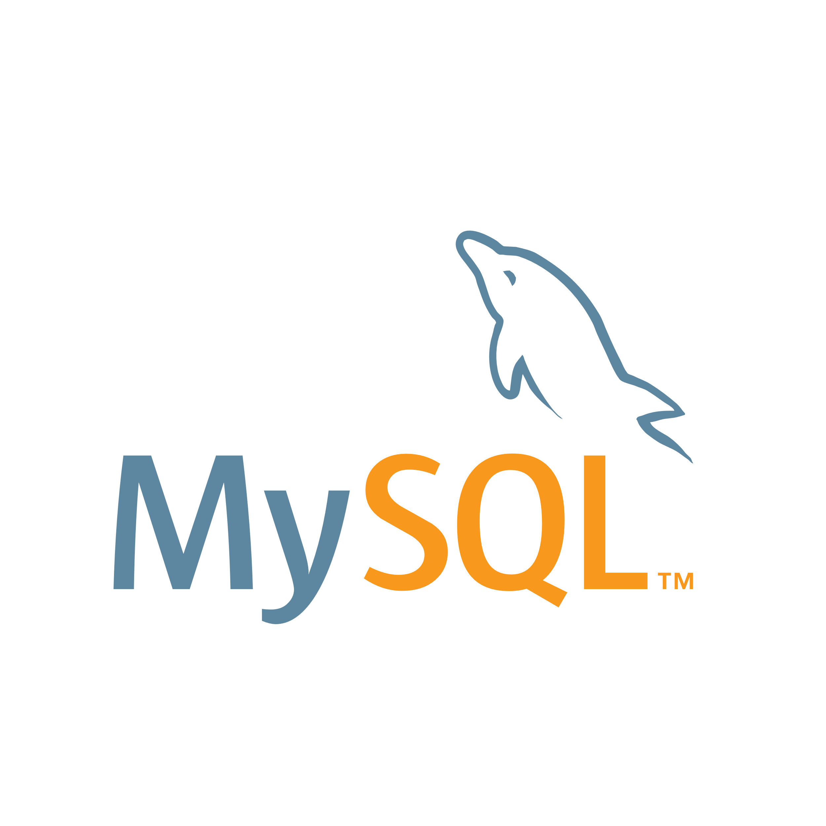

To SQL or Not to SQL
Relational Databases
Non-Relational Databases
Got that ORM benefits
Requires API endpoints for database interactions

Slide 15
Components of a Framework
Relational Databases
Non-Relational Databases
Mercury is the closest planet to the Sun and the smallest one in the Solar System—it’s only a bit larger than the Moon. This planet’s name has nothing to do with the liquid metal, since Mercury was named after the Roman messenger god
Got that ORM benefits
Venus has a beautiful name and is the second planet from the Sun. It’s terribly hot—even hotter than Mercury—and its atmosphere is extremely poisonous. It’s the second-brightest natural object in the night sky after the Moon
Requires API endpoints for database interactions

Slide 16
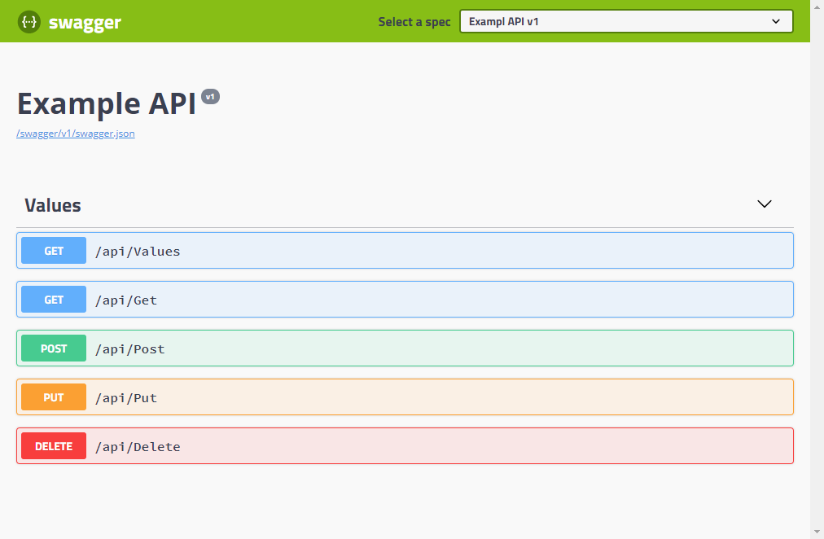
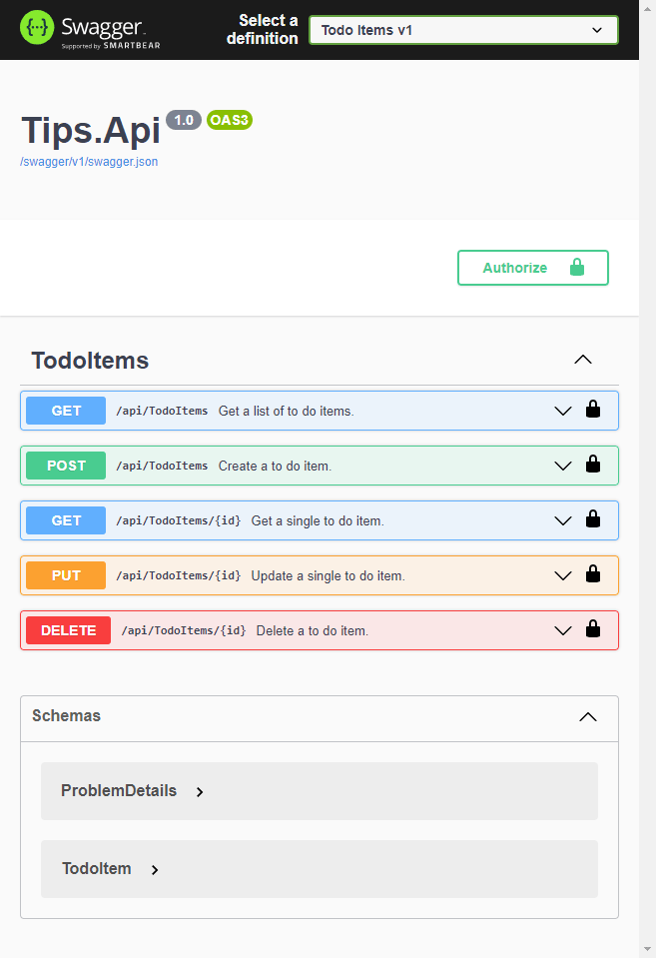

Front End Frameworks
Handles the ‘View’ for ye MVC Focused on design implementation of application development/APIs Provides responsive design

Slide 17
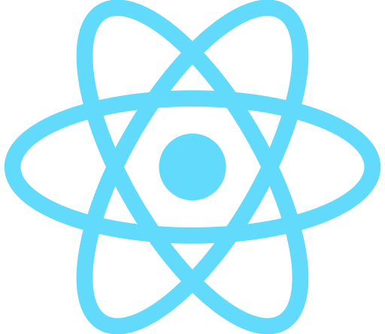




Popular Front End Frameworks
React | React Native | Flutter | Ionic
JavaScript | JavaScript | Dart | ??
Example 1 Example 2 Example 3 | Example 1 Example 2 Example 3 | Example 1 Example 2 Example 3 | Example 1 Example 2 Example 3

Slide 18
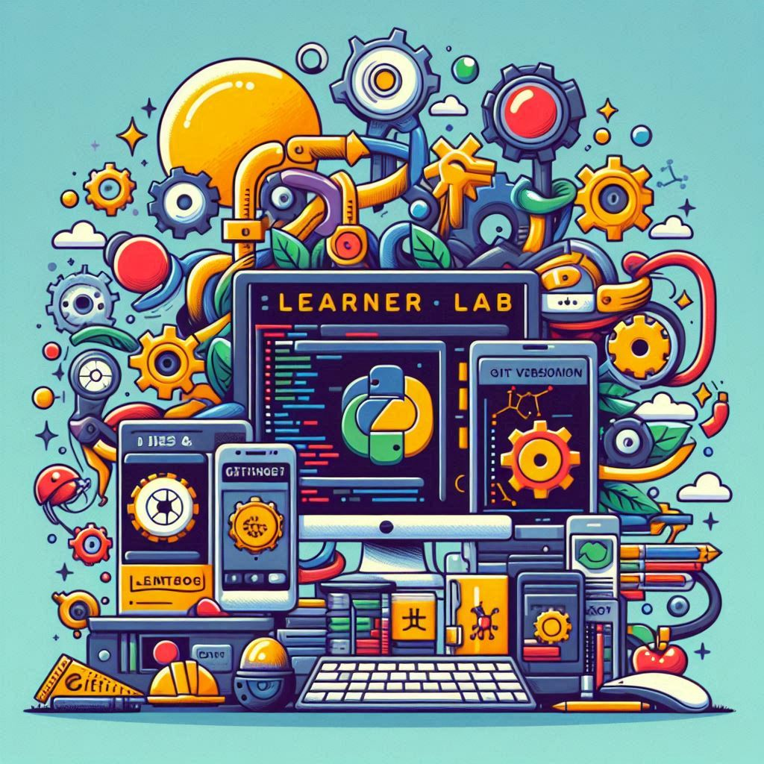
03
IDEs & Git Versioning
Notes:
WHATS AN IDE
- integrated development environment, what it good for
- file explorer/manager, many files open at once
- terminal, execution, debugging
- extensions/remote access/testing and debugging
- language and feature support (virutal environments)
- recommended extensions for web development - thunderclient (replaces postman), remote explorer (ssh)
COMPARISON
- why use vscode or alternatives
- cloud native ide's (AWS Cloud9) and additional intergration
USING GITHUB
- git in general
- version control/rollback/branches & forks
- easily clone project and update the repo from any location/machine
- it can be any directory (creates a hidden file that is used to connect and compare to the repo)
- using python virtual environments to isolate all project dependencies

Slide 19
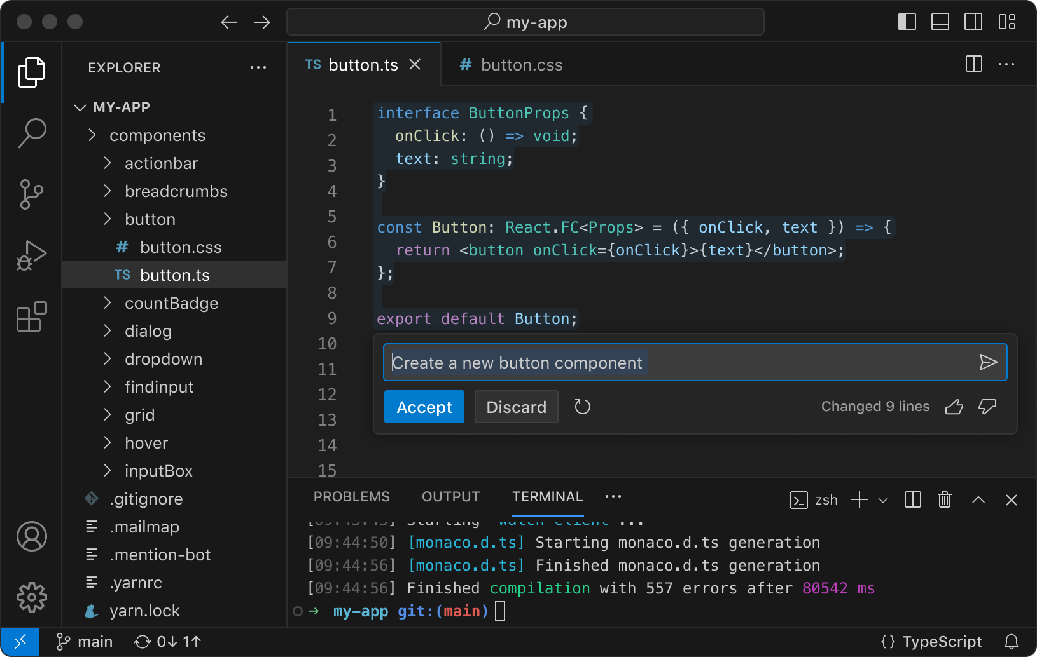

Why use an IDE like VS Code?
Explorer
Files/Code
Benefits:
Multiple files open at once
Easy directory navigation
Remote connections/SSH
Extensions provide support for multiple languages and services
Debugging and testing
Version control
Integration with services and virtual environments
One stop shop for project, centralizing the development process in one application
Code completion/suggestions, class information
Code colorization
Syntax/error detection
And the most important thing: you’re a sick cunt
Extensions
Terminal
Notes:
After the django server VM installation is complete
ENABLE REMOTE CONNECTIONS ON DJANGO SERVER (VM)
Install the OpenSSH server, which is required for remote connections.
> sudo apt install openssh-server
This command will display the IP address (eg: 192.168.0.40)
> ip a
CONNECT FROM HOST MACHINE WITH VS CODE
Install Remote Explorer extension
Go to the Remote Explorer tab and click the ‘+’ to add a new address. A input field will drop down at the top – input the command to connect to the target machine: ssh <username>@<Django-server-ip> -A
You’re given the choice of which config file to update. Choose the one for your user, eg: C:\Users\Luke\.ssh\config
This adds the Django server address to the config file. To see it under the SSH listings, you will need to refresh the list by clicking the refresh button for ‘REMOTES TUNNELS/SSH’, and then the drop down arrow for SSH.
You should see the IP of the server, choose to either connect in the current window or open a new one.
Another input field will drop down from the top – enter the password for the Django server user.
The terminal will now be connected to the Django server. To use the File explorer, lick ‘Open Folder’ and choose the directory you want to open. You can choose the users home directory but to simplify the display, it’s recommended you open the directory where you created the Django project (or where you cloned the learnerlab repo).
You will need to input the password for the user once more in the drop down input field at the top.
To close the remote connection, click the SSH: <Django-ip> in the bottom left corner, ‘close remote connection
OPTIONAL STEPS TO INSTALL node.js and expo cli - FOR REACT DEVELOPMENT
Install nvm (Node Version Manager):
> curl -o- https://raw.githubusercontent.com/nvm-sh/nvm/v0.39.5/install.sh | bash
Reload your shell configuration:
> source ~/.bashrc
Install the latest Node.js version with the node version manager:
> nvm install node
Verify Node.js installation:
> node -v
Install Expo CLI:
> npm install -g expo-cli
Create a new Expo project:
> expo init project2

Slide 20

Popularity of VS Code
10%
30%
Venus
Jupiter
Venus is the second planet from the Sun
It’s the biggest planet in the Solar System
40%
20%
VS Code
Saturn
Despite being red, Mars is a cold place
Saturn is a gas giant and has several rings
Follow the link in the map to modify its data and then paste the new one here. For more info, click here

Slide 21
Version Control
Step 1
Step 2
Step 3
Step 4
Earth is the only planet known to harbor life
Despite being red, Mars is actually a cold place
Jupiter is the biggest planet in the Solar System
Saturn has a high number of moons, like Jupiter

Slide 22

04
Project Contents & Deployment

Slide 23
Components of a Django Project
Backend
A
B
Front End
Model
C
D
Views
Django
Database
E
F
URLs
APIs
G
H
UI/UX

Slide 24
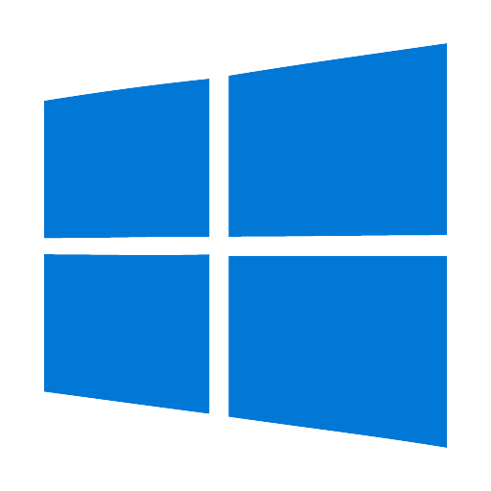
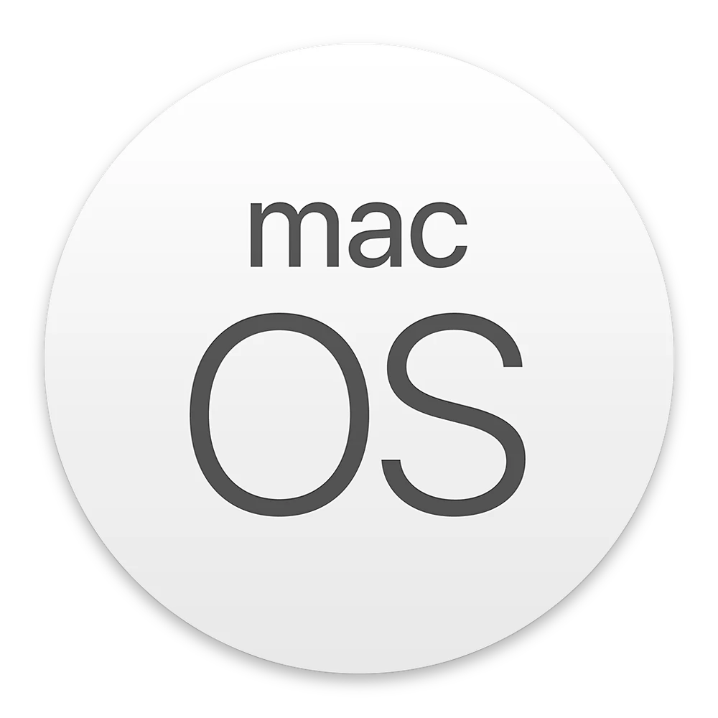
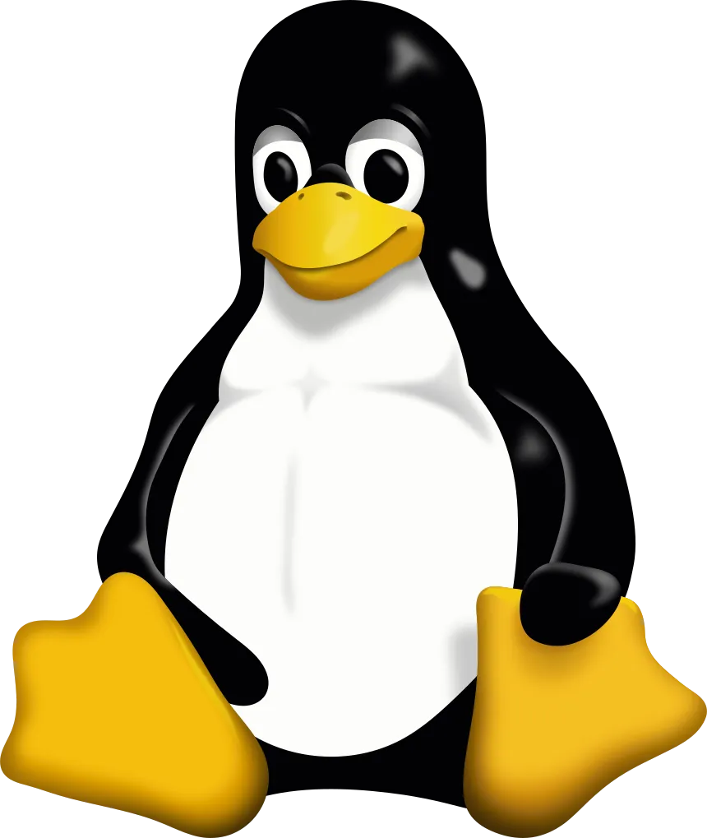
Virtual Machines
Neptune
Neptune is the farthest planet from the Sun
Jupiter
Jupiter was named after a Roman god
Digital Transformation
Mercury
Mercury is the closest planet to the Sun
Venus
Venus is the second planet from the Sun

Slide 25
Servers & Containers
from pptx import Presentation
How a project is made available via web server
Mercury is the closest planet to the Sun and the smallest one in the entire Solar System. This planet's name has nothing to do with the liquid metal, since Mercury was named after the Roman messenger god. Despite being closer to the Sun than Venus, its temperatures aren't as terribly hot as that planet's. Its surface is quite similar to that of Earth's Moon, which means there are a lot of craters and plains
Speaking of craters, many of them were named after artists or authors who made significant contributions to their respective fields. Mercury takes a little more than 58 days to complete its rotation, so try to imagine how long days must be there! Since the temperatures are so extreme and the solar radiation is so high, Mercury has sadly been considered to be non-habitable for humans

Slide 26
SDLC & CI/CD Pipelines
Development
Testing
Despite being red, Mars is actually a cold place. It’s full of iron oxide dust, which gives the planet its reddish cast, and it’s made of basalt
Venus has a beautiful name and is the second planet from the Sun. It’s terribly hot and its atmosphere is extremely poisonous
Production
Continuous
Jupiter is a gas giant and the biggest planet in the Solar System. It’s the fourth-brightest object in the night sky and was named after a god
Saturn is a gas giant and has several rings. It’s composed mostly of hydrogen and helium. It’s the sixth planet from the Sun

Slide 27
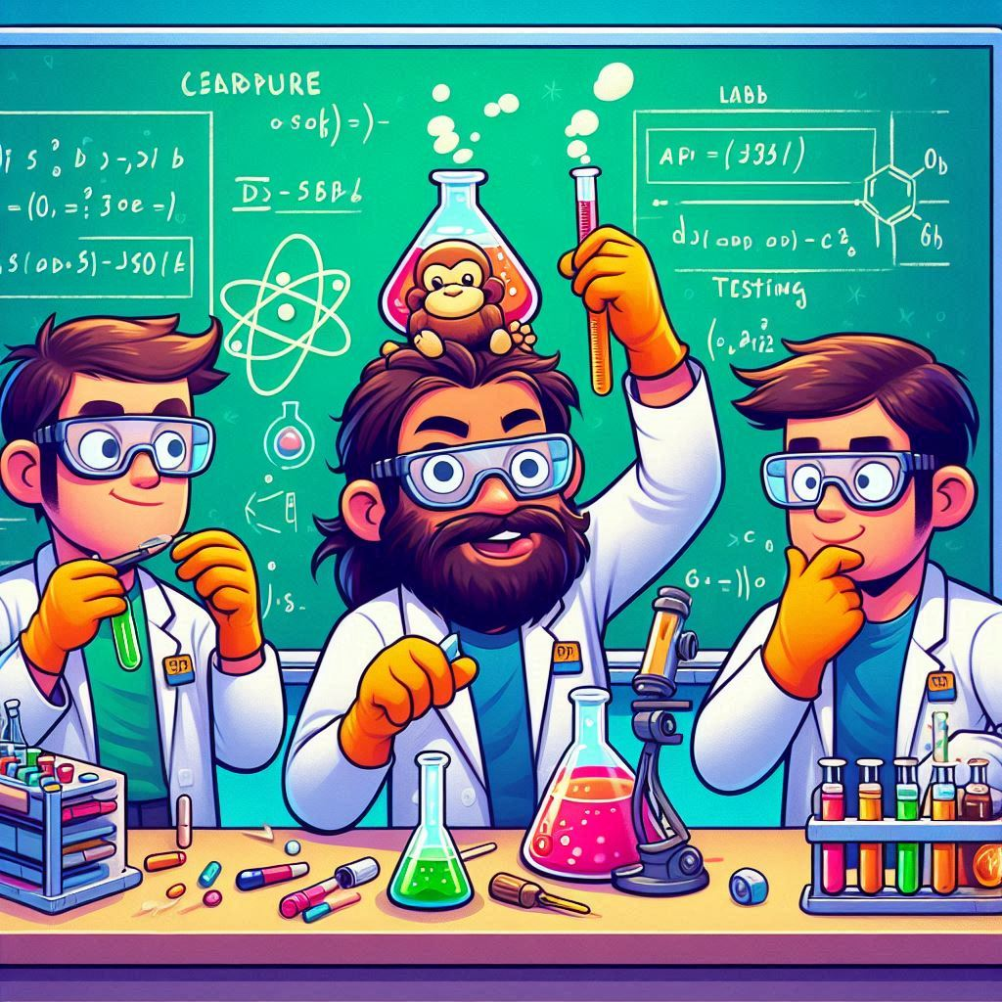
05
APIs & Testing
Notes:
API CONSIDERATIONS
- documentation with Swagger
- testing with postman/thunderclient
- CORS cross origin resource sharing

Slide 28
Application Programming Interfaces
Venus
Mars
What is this shit?
Why do they need to be defined?
Examples
You can write the details here
You can write the details here
You can write the details here
You can write the details here
You can write the details here
You can write the details here
You can write the details here
You can write the details here
You can write the details here
You can write the details here
You can write the details here
You can write the details here
You can write the details here

Slide 29
How a Client Interacts with API
Step 1
Step 2
Step 3
Step 4
Venus is a hot planet
Mercury is very small
Mars is made of basalt
Jupiter is a gas giant
Step 5
Step 6
Step 7
Step 8
Saturn has rings
The Sun is a star
Earth harbors life
Neptune is an ice giant

Slide 30


Testing APIs
Explorer
Files/Code
Benefits:
Multiple And the most important thing: you’re a sick cunt
Extensions
Terminal
Notes:
After the django server VM installation is complete
ENABLE REMOTE CONNECTIONS ON DJANGO SERVER (VM)
Install the OpenSSH server, which is required for remote connections.
> sudo apt install openssh-server
This command will display the IP address (eg: 192.168.0.40)
> ip a
CONNECT FROM HOST MACHINE WITH VS CODE
Install Remote Explorer extension
Go to the Remote Explorer tab and click the ‘+’ to add a new address. A input field will drop down at the top – input the command to connect to the target machine: ssh <username>@<Django-server-ip> -A
You’re given the choice of which config file to update. Choose the one for your user, eg: C:\Users\Luke\.ssh\config
This adds the Django server address to the config file. To see it under the SSH listings, you will need to refresh the list by clicking the refresh button for ‘REMOTES TUNNELS/SSH’, and then the drop down arrow for SSH.
You should see the IP of the server, choose to either connect in the current window or open a new one.
Another input field will drop down from the top – enter the password for the Django server user.
The terminal will now be connected to the Django server. To use the File explorer, lick ‘Open Folder’ and choose the directory you want to open. You can choose the users home directory but to simplify the display, it’s recommended you open the directory where you created the Django project (or where you cloned the learnerlab repo).
You will need to input the password for the user once more in the drop down input field at the top.
To close the remote connection, click the SSH: <Django-ip> in the bottom left corner, ‘close remote connection
OPTIONAL STEPS TO INSTALL node.js and expo cli - FOR REACT DEVELOPMENT
Install nvm (Node Version Manager):
> curl -o- https://raw.githubusercontent.com/nvm-sh/nvm/v0.39.5/install.sh | bash
Reload your shell configuration:
> source ~/.bashrc
Install the latest Node.js version with the node version manager:
> nvm install node
Verify Node.js installation:
> node -v
Install Expo CLI:
> npm install -g expo-cli
Create a new Expo project:
> expo init project2

Slide 31

APIs and Documentation
Auto-generate API documentation of an existing project with Swagger/alternatives Detail how this documentation can be used to create connections with external services – providing them with the available API endpoints for the application

Slide 32

06
Learner Labs
Notes:
INTRO TO LEARNER LABS AND WHAT THEY COVER
Links
Assumed knowledge – basic github/auth connections
What they don’t cover – front end frameworks, security, authentication/tokens

Slide 33
Purpose of the Django Learner Labs
Setup Development Environment
Use Git Repo & IDE Tools
Despite being red, Mars is actually a cold place. It’s full of iron oxide dust
Venus has a beautiful name and is the second planet from the Sun
Explore Existing Projects
Test & Document API Endpoints
Create New Projects
Mercury is the closest planet to the Sun and the smallest of them all
Saturn was named after the Roman god of wealth and agriculture
Jupiter is a gas giant and the biggest planet in the Solar System

Slide 34
Learning Resources
Django Official:
https://docs.djangoproject.com/en/4.1/intro/tutorial01/ --→ deprecated
W3 Schools:
https://www.w3schools.com/django/
A python + django cheat sheet is available here:
https://dev.to/ericchapman/my-beloved-django-cheat-sheet-2056
Notes:
Django Official:
https://docs.djangoproject.com/en/4.1/intro/tutorial01/ --→ deprecated
W3 Schools:
https://www.w3schools.com/django/
A python + django cheat sheet is available here:
https://dev.to/ericchapman/my-beloved-django-cheat-sheet-2056

Slide 35


Thanks!
Do you have any questions?
lukewait@outlook.com
https://github.com/LukeWait
LinkedIn/LukeWait
Please keep this slide for attribution

Slide 36
Here are three important ideas
Jupiter
Venus
Saturn
Jupiter is a gas giant and the biggest planet in the Solar System. It's the fourth-brightest object in the night sky and was named after the Roman god of the skies
Venus has a beautiful name and is the second planet from the Sun. It’s terribly hot and its atmosphere is poisonous. It’s the second-brightest natural object in the night sky
Saturn is a gas giant and has several rings. This planet is composed mostly of hydrogen and helium. It’s the sixth planet from the Sun and was named after a Roman god too

Slide 37
You can divide the content
Mercury
Venus
Mercury is the closest planet to the Sun and the smallest one in the Solar System—it’s only a bit larger than the Moon. This planet’s name has nothing to do with the liquid metal, since Mercury was named after the Roman messenger god
Venus has a beautiful name and is the second planet from the Sun. It’s terribly hot—even hotter than Mercury—and its atmosphere is extremely poisonous. It’s the second-brightest natural object in the night sky after the Moon

Slide 38
Divide the content into four ideas
Mars
Venus
Despite being red, Mars is actually a cold place. It’s full of iron oxide dust, which gives the planet its reddish cast, and it’s made of basalt
Venus has a beautiful name and is the second planet from the Sun. It’s terribly hot and its atmosphere is extremely poisonous
Jupiter
Saturn
Jupiter is a gas giant and the biggest planet in the Solar System. It’s the fourth-brightest object in the night sky and was named after a god
Saturn is a gas giant and has several rings. It’s composed mostly of hydrogen and helium. It’s the sixth planet from the Sun

Slide 39
Reviewing concepts is a good idea
Mars
Venus
Neptune
Despite being red, Mars is actually a cold place. It’s full of iron oxide dust, which gives the planet its reddish cast
Venus has a beautiful name and is the second planet from the Sun. It’s terribly hot, even hotter than Mercury
Neptune is the farthest planet from the Sun. It’s also the fourth-largest planet by diameter in the Solar System
Earth
Saturn
Jupiter
Earth is the third planet from the Sun and the only one in the Solar System that harbors life. We all live on this planet
Saturn is a gas giant and has rings. It's composed mostly of hydrogen and helium. It’s the sixth planet from the Sun
Jupiter is a gas giant and the biggest planet in the Solar System. It’s the fourth-brightest object in the night sky

Slide 40
Conclusion
Venus
Mars
You can write the details here
You can write the details here
You can write the details here
You can write the details here
You can write the details here
You can write the details here
You can write the details here
You can write the details here
You can write the details here
You can write the details here
You can write the details here
You can write the details here
You can write the details here
You can write the details here
You can write the details here
You can write the details here

Slide 41
Anticipated industry changes
Step 1
Step 2
Step 3
Step 4
Earth is the only planet known to harbor life
Despite being red, Mars is actually a cold place
Jupiter is the biggest planet in the Solar System
Saturn has a high number of moons, like Jupiter

Slide 42
Frameworks for implementation
Neptune
Neptune is the farthest planet from the Sun
Jupiter
Jupiter was named after a Roman god
Digital Transformation
Mercury
Mercury is the closest planet to the Sun
Venus
Venus is the second planet from the Sun

Slide 43
Impact on industries
Venus
Neptune
Venus is the second planet from the Sun
It’s the biggest planet in the Solar System
Jupiter
Saturn
Jupiter doesn’t have a solid surface
Saturn is a gas giant and has several rings
Earth
Mars
Earth is the only planet that harbors life
Despite being red, Mars is actually a cold place

Slide 44
Use tables to represent data
 | Team A | Team B | Team C | Team D | Team E | Team F
Mercury | XX | XX | XX | XX | XX | XX
Mars | XX | XX | XX | XX | XX | XX
Saturn | XX | XX | XX | XX | XX | XX
Venus | XX | XX | XX | XX | XX | XX
Jupiter | XX | XX | XX | XX | XX | XX
Earth | XX | XX | XX | XX | XX | XX
Pluto | XX | XX | XX | XX | XX | XX

Slide 45
Let’s use some percentages
25%
50%
75%
Mercury
Venus
Mars
Mercury is the closest planet to the Sun and the smallest one of them all
Venus has a beautiful name and is the second planet from the Sun
Despite being red, Mars is actually a cold place. It’s full of iron oxide dust

Slide 46
This is a map
Mars
Mars is very cold
Mercury
Mercury is small
Venus
Venus is very hot
Follow the link in the map to modify its data and then paste the new one here. For more info, click here

Slide 47
Popular Front End Frameworks
Team 1
Team 2
Team 3
Team 4
Follow the link in the map to modify its data and then paste the new one here. For more info, click here

Slide 48
You can use another graph
10%
30%
Venus
Jupiter
Venus is the second planet from the Sun
It’s the biggest planet in the Solar System
40%
20%
Mars
Saturn
Despite being red, Mars is a cold place
Saturn is a gas giant and has several rings
Follow the link in the map to modify its data and then paste the new one here. For more info, click here

Slide 49


Our team
Sofia Hill
John Harris
You can speak a bit about this person here
You can speak a bit about this person here

Slide 50
— Someone Famous
“This is a quote, words full of wisdom that someone important said and that can inspire the reader”

Slide 51
Awesome words

Slide 52

A picture always reinforces
the concept
Images reveal large amounts of data, so remember: use an image instead of a long text. Your audience will appreciate it

Slide 53
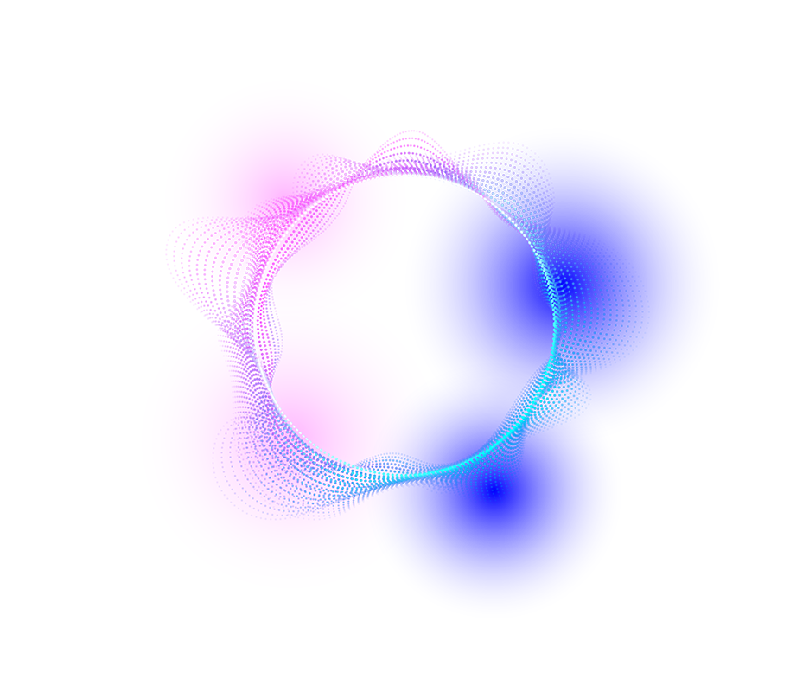

A picture is worth a thousand words

Slide 54
98,300,000
Big numbers catch your audience’s attention

Slide 55

9h 55m 23s
333,000
386,000 km
Jupiter’s rotation period
The Sun’s mass compared to Earth’s
The distance between Earth and the Moon

Slide 56
Contents of this template
You can delete this slide when you’re done editing the presentation
Fonts | To view this template correctly in PowerPoint, download and install the fonts we used
Used and alternative resources | An assortment of graphic resources that are suitable for use in this presentation
Thanks slide | You must keep it so that proper credits for our design are given
Colors | All the colors used in this presentation
Icons and infographic resources | These can be used in the template, and their size and color can be edited
Editable presentation theme | You can edit the master slides easily. For more info, click here
For more info: SLIDESGO | BLOG | FAQs
You can visit our sister projects: FREEPIK | FLATICON | STORYSET | WEPIK | VIDEVO
#ffffff
#000658
#000641
#ff00ff
#0067ff
#4993ff

Slide 59
JANUARY
FEBRUARY
MARCH
APRIL
MAY
JUNE
PHASE 1
Task 1
Task 2
PHASE 2
Task 1
Task 2
JANUARY
FEBRUARY
MARCH
APRIL
PHASE 1
Task 1
Task 2

Slide 63
Educational Icons
Medical Icons

Slide 65
Help & Support Icons
Avatar Icons

Slide 66
Creative Process Icons
Performing Arts Icons

